Slide 1
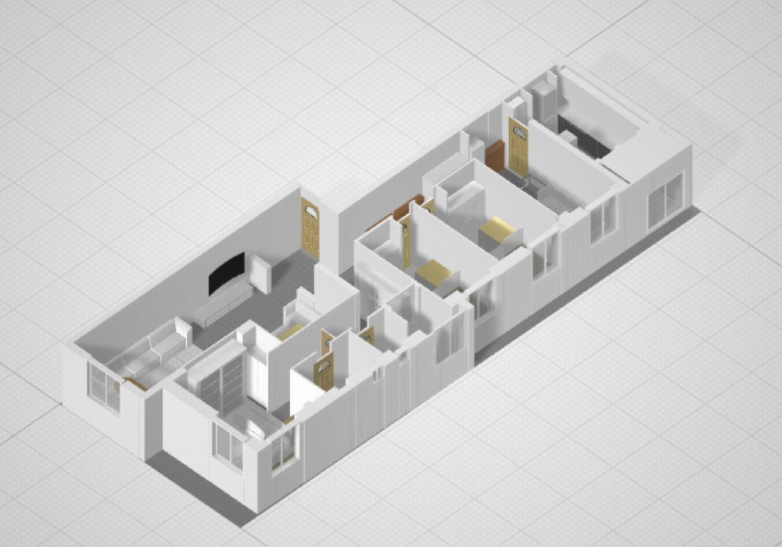
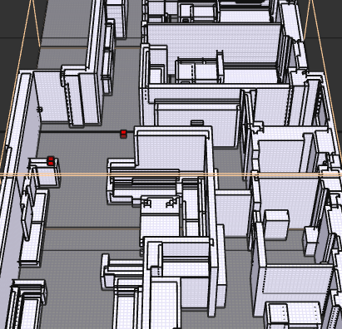
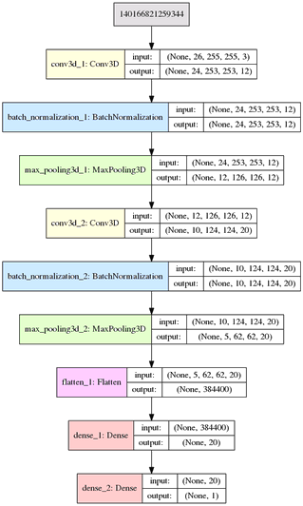
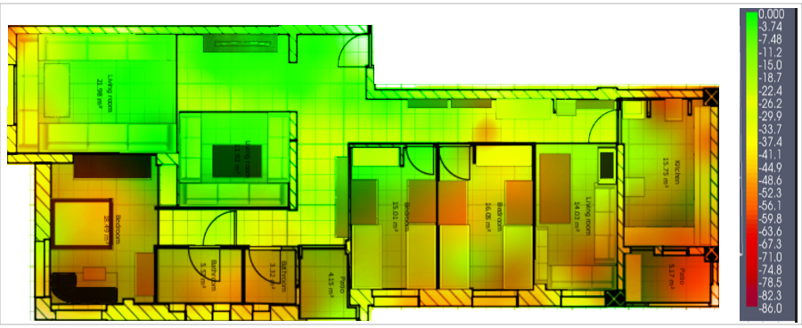
Deep learning of Indoor Radio Link Quality Prediction in Wireless Networks using Floor Plans
Authors: Yaqoob Ansari, Nouha Tiyal Advisors: Saquib Razak, Eduardo Feo Flushing
The research aims to provide a neural network model that predicts network strength given a floor plan and a transmitter location, the model can help solve several problems including optimal placement of access points, detecting network blind spots, etc. and can be an alternative to computationally intensive solutions such as raytracing.
Floorplan Generation
Data Generation
Voxels => similar to
pixels but for 3D
images.
=> The 3D floor-plan
was constructed and
voxelized then was
marked with locations
of the access point and
data sampling points.
RSS => The data collected was the Received Signal Strength (RSS) of the network.
Data Collection => At marked sites, each around 15cm apart (1712 sites in total), over a duration of 1min/site.
Data Processing =>
The data was filtered for outliers using IQD method.
The mean value of filtered RSS values was kept for each location.
Data Augmentation => Artificial samples were added based on the raw dataset distribution in order to balance it and ensure holistic model training.
AOI => Data points were also assigned values based on their distance from the access points.
Model & Results
Three models were created with varying neuron density.
The best performing model:
ADAM optimizer
Architecture: 2 conv, 2 dense layers.
Loss: 5.5 dBms [MAE]
Great accuracy
Good generalization property.
Calculate
Distance from AP
Sender Location
Model
RSS Value
AOI Value
Raw Input
Encode
Encoded Floor plan
Floor Plan

Slide 2
Deep learning of Indoor Radio Link Quality Prediction in Wireless Networks using 3D Floor Plans
Authors:
The research aims to provide solution to problem of placement of devices at optimal positions, adopting an approach to design and train a deep learning model that uses radio link quality of wireless network to predict network strength.
- A 3D visualization of the floorplan of the building was constructed.
- The 3D model was voxelized.
- Voxelized model was marked with locations of the access point and data sampling points.
- The voxelized models were converted into Numpy matrices and were fed to the deep learning model.

Slide 3
Calculate
Distance from AP
Sender Location
Model
RSS Value
AOI Value
Raw Input
Encode
Encoded Floor plan
Floor Plan

